Slide 1


Final React Native
Group 5

Slide 2
Agenda
Group introduction
What is your project about?
Framework or library that you use in project?
Challenging
Screenshot of project
Questions and Answers
Group 5

Slide 3
Group introduction
Touch Chanly
Nhor Sokhorn
Ouk Puthy
Ran Virak(Leader)
Chhorn Vannuth
Deu Makara
Group 5

Slide 4

II. What is your project about?
Our project we do on POST that describe about posting on social media.
Group 5

Slide 5





III. Framework or library that you use in project?
API: Node
Front-end: The post app our group use the React-Native an open-source JavaScript framework to build the application.
Group 5

Slide 6
IV. Challenging
Facing an issue/error
Researching
Team discussion
Group 5

Slide 7
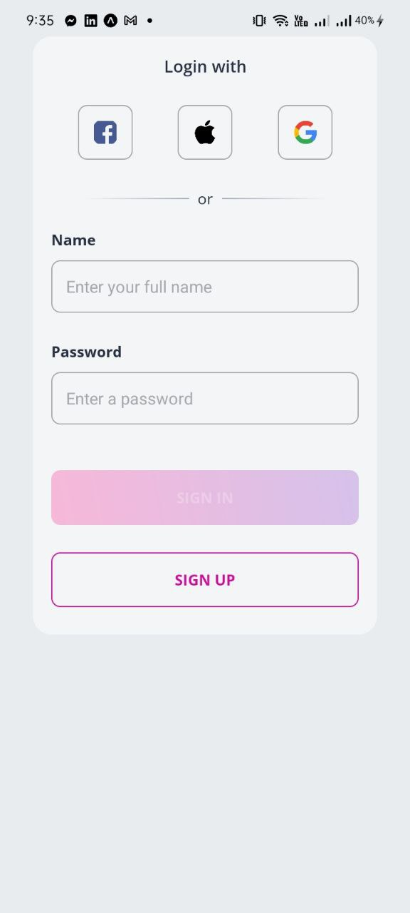
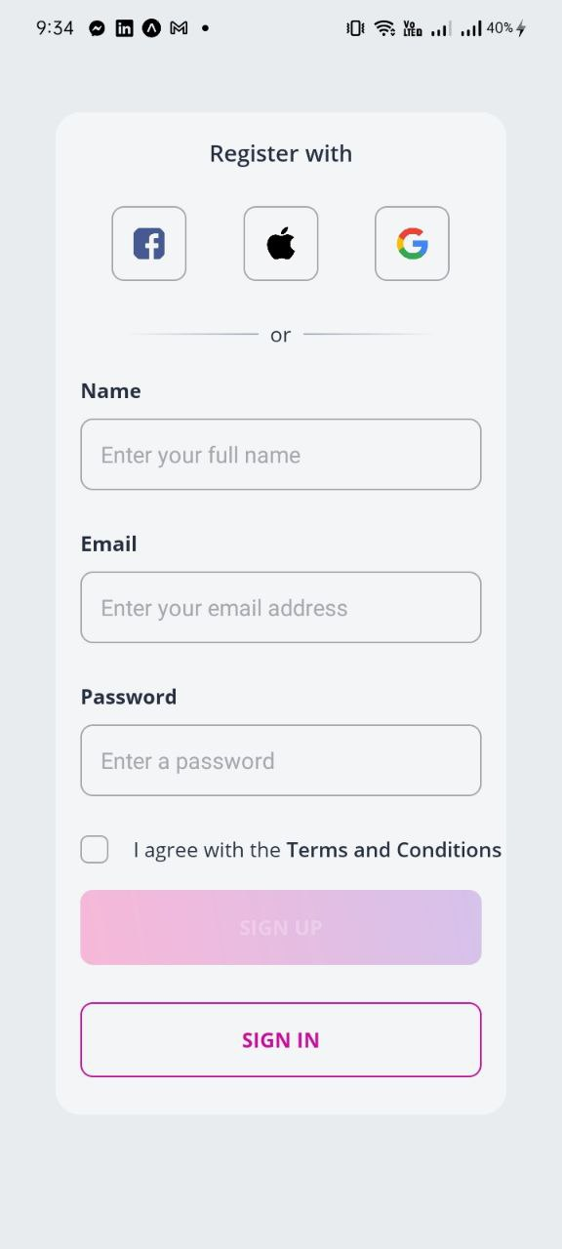
V. Screenshot or demo of project.
Group 5

Slide 8
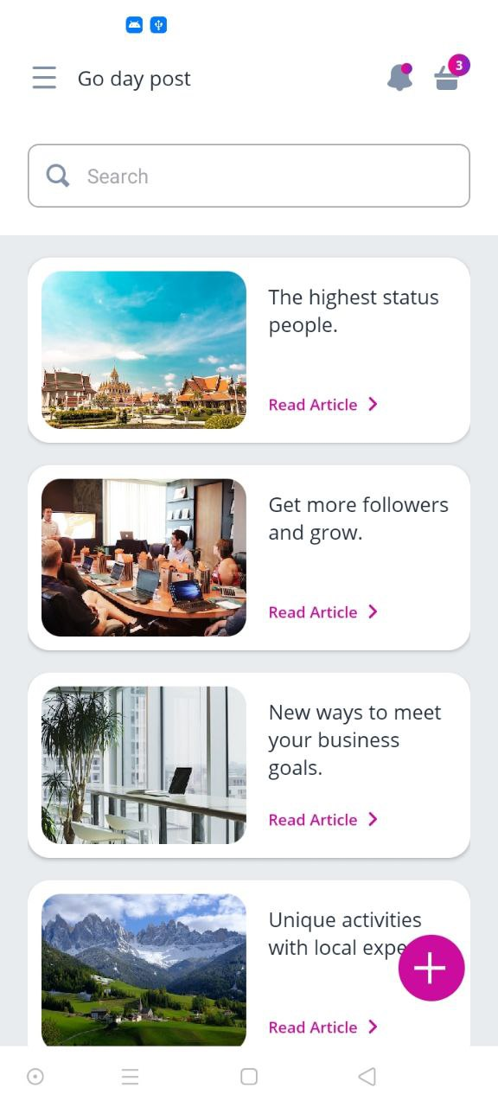
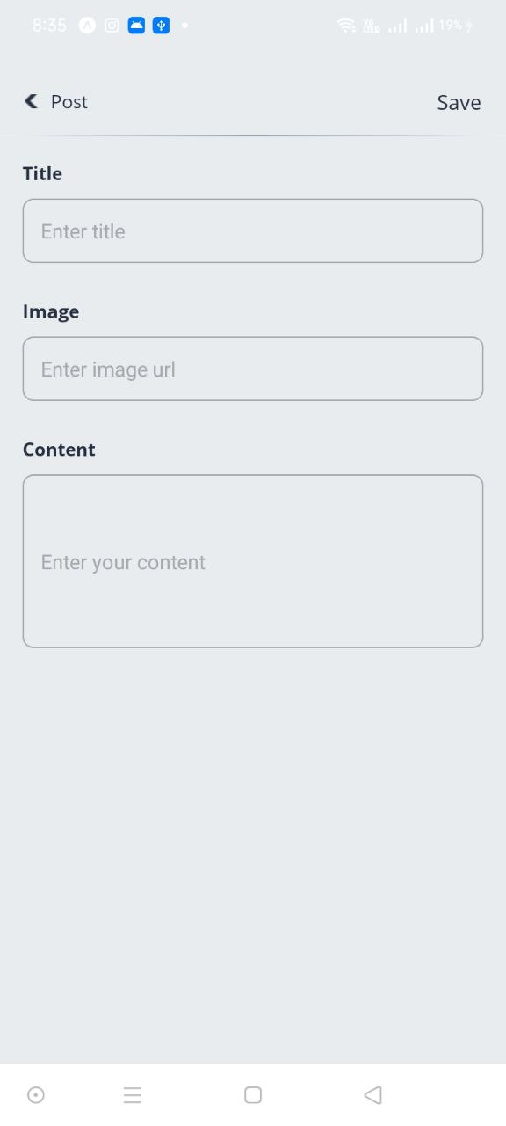

Slide 9


Slide 10

Group 5

